Slide 1
I211 – Information Infrastructure II
Lecture 6

Slide 2
Basic UNIX - Topic Summary
Files and Directories
Navigating the system
Create, copy, move, delete, display
Redirection
Wildcards
Changing permissions / executing files

Slide 3
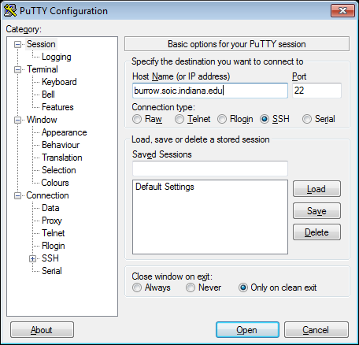
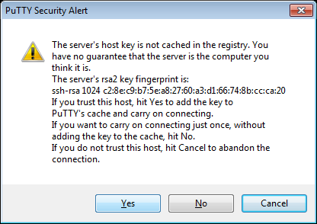
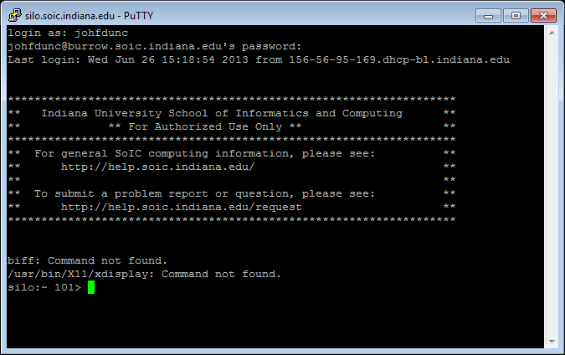
Logging in with PuTTY
Use PuTTY to connect to burrow.soic.indiana.edu
Log in as yourself!

Slide 4
Basic UNIX – Server Info / Pico
SoIC UNIX Server:
burrow.soic.indiana.edu
Web server, DB space
Unix Basics: http://kb.iu.edu/data/apek.html
Unix Commands: http://kb.iu.edu/data/afsk.html

Slide 5
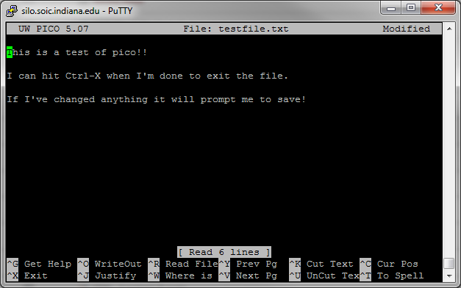
Basic UNIX - Pico
Text Editor: Pico – easiest editor! (Emacs, VI)
Type pico <filename> This can create new files!
If you’ve changed anything, it prompts you to Save – type ‘Y’ for yes (it confirms the file name) or ‘N’ for no.
Ctrl-X to exit
(^ means ‘Ctrl’)

Slide 6
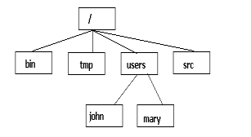
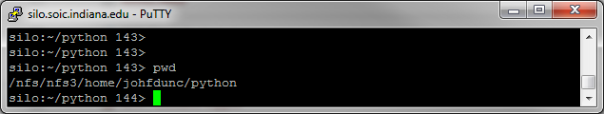
Basic UNIX – File System
The file system is a tree
By default, you log in to your home directory
Type pwd to see the full path to your current directory

Slide 7
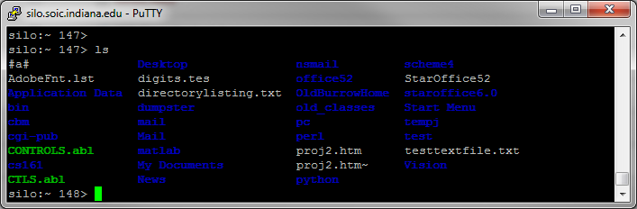
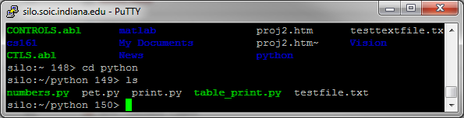
Basic UNIX – Directory Operations
ls allows you to view files and directories
cd <directory> allows you to move into another directory

Slide 8
Changing Directories
Moving around directories:
cd .. Takes us down a directory
cd ../.. Takes us down two directories, etc.
cd ~ takes us to our home directory!
cd / will take you down to the root directory of the machine!
If we’re in /users/mary and we want to go to /bin, we need to go down two directories and then up one:
cd ../../bin

Slide 9
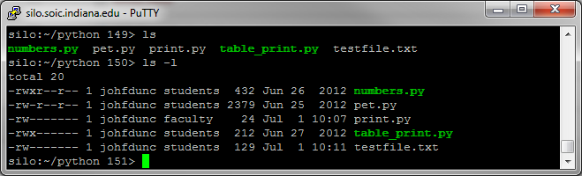
Basic UNIX – Using ls
Additional Flags for ls:
ls –a lists all files AND all hidden (system) files
ls –l lists all files with details:
File permissions
Size
Date modified
You can put stuff after ls to make it more specific:
ls –l <filename>

Slide 10
Basic UNIX - File Operations
mkdir <name> creates a directory with that name
rm <name> removes that file
rm –r <name> removes a directory and all its files
cp <fileold> <filenew> copies a file
mv <fileold> <filenew> renames (moves) a file
cat <name> prints out the contents of a file
Use more <name> for long files. Press SPACE to move through the file

Slide 11
Basic UNIX – Last Commands
At the command prompt, you can press the UP arrow or the DOWN arrow to cycle through your previously entered commands.
If you want to repeatedly run the same command (for example, to execute a program), this saves you time.

Slide 12
UNIX Basics 1 (Group Work)
Have at least 1 person in your group (Ideally, all of you) log into Burrow and create 2 directories: “I211 HW” and “I211 Lecture”
In the “I211 Lecture” directory, create a directory called “Lecture 6”.
In the “Lecture 6” directory, create a file called “food.txt” and put your favorite food(s) in there.
Show us that you can navigate to your home directory, then up to the “Lecture 6” directory, and then print out the contents of “food.txt”

Slide 13
UNIX Basics 1 (Solution)
cd ~
mkdir I211 HW
mkdir I211 Lecture
cd I211 Lecture
mkdir Lecture 6
cd Lecture 6
pico food.txt
<enter foods>, Ctrl-X, Y
cd ~
cd I211 Lecture/Lecture 6
more food.txt

Slide 14
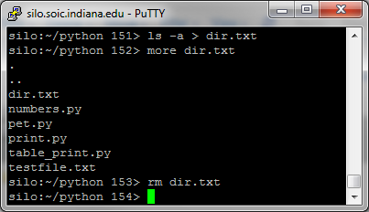
Basic UNIX – Redirect to File
Redirection
If you add > <filename> to one of these commands, it saves the output into a file instead of displaying it
If you add >> <filename>, the output will be appended to the end of the file
Example:
ls –a > dir.txt
more dir.txt
rm dir.txt

Slide 15
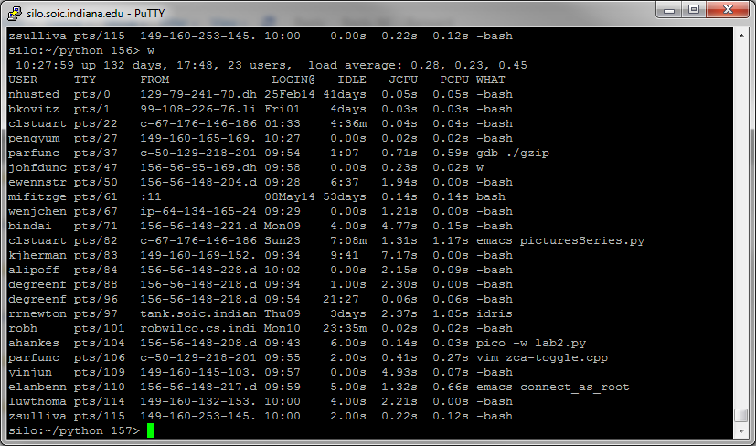
Basic UNIX - Burrow
The Burrow cluster is a collection of machines, not just one.
Use the who command to see who else is logged into your current machine, and the w command to see a bit about what they’re doing:
If a user on the physical machine reboots it, you may lose your connection! Save often!

Slide 16
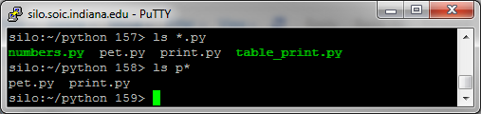
Basic UNIX - Wildcards
Wildcards – Most UNIX commands support wildcards, which help you to not have to type an entire filename or query
* = match anything
Ex:
ls *.py
ls p*

Slide 17
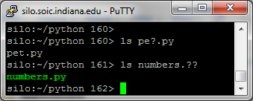
Basic UNIX - Wildcards
Wildcards – Most UNIX commands support wildcards, which help you to not have to type an entire filename or query
? = match a single letter or digit
Ex:
ls pe?.py
ls numbers.??

Slide 18


Basic UNIX - Autocomplete
Autocomplete – When typing file names, you can hit TAB . If only 1 file matches the current name, it will autocomplete it for you!
If multiple file names match, nothing happens. Try typing a few more letters!

Slide 19
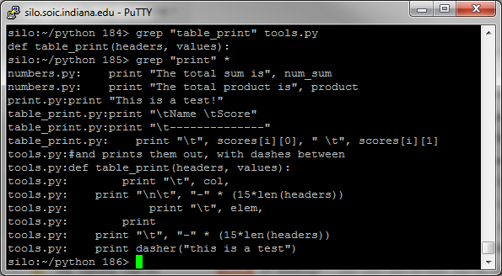
Basic UNIX - Grep
grep is a useful program for finding things in files. The syntax is grep <pattern> <file(s)>

Slide 20
Get a Grep (Group Work)
w will show you details about who’s logged in and what they’re doing.
Run w 3 times and append all of the results to a file called people.txt
Search people.txt for your username, which should produce three results.

Slide 21
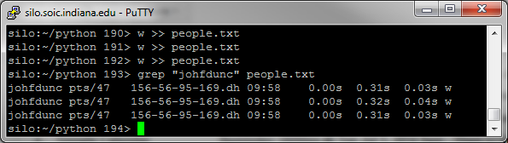
Get a Grep (Solution)

Slide 22
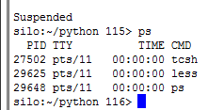
Basic UNIX
View running processes:
Type ps to see what you have running
If you see tcsh or bash, those are your shell (don’t stop them!!)
Stop a process
If a process locked up, you may need to kill it (close it manually)
Type kill -9 <processid> to kill it

Slide 23
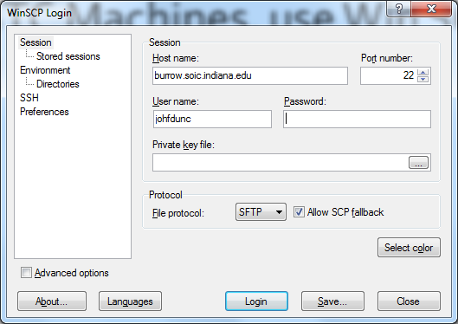
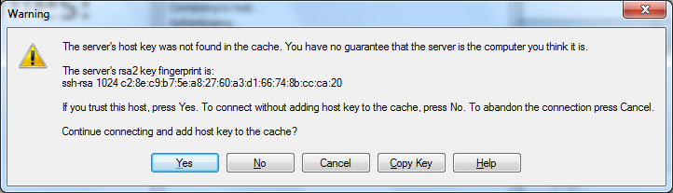
Win SCP
It’s easier to write a Python file on your local machine, where you can use IDLE. So we need to get files onto Burrow machines.
On STC Machines, use Win SCP:

Slide 24
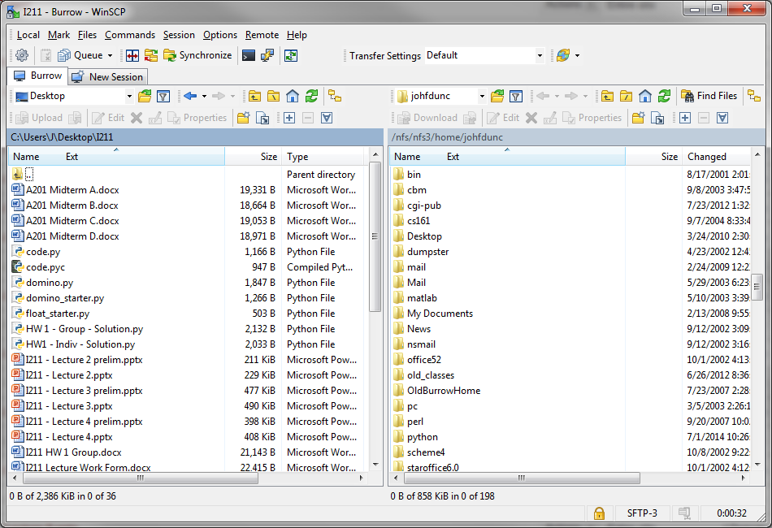
Win SCP Interface

Slide 25
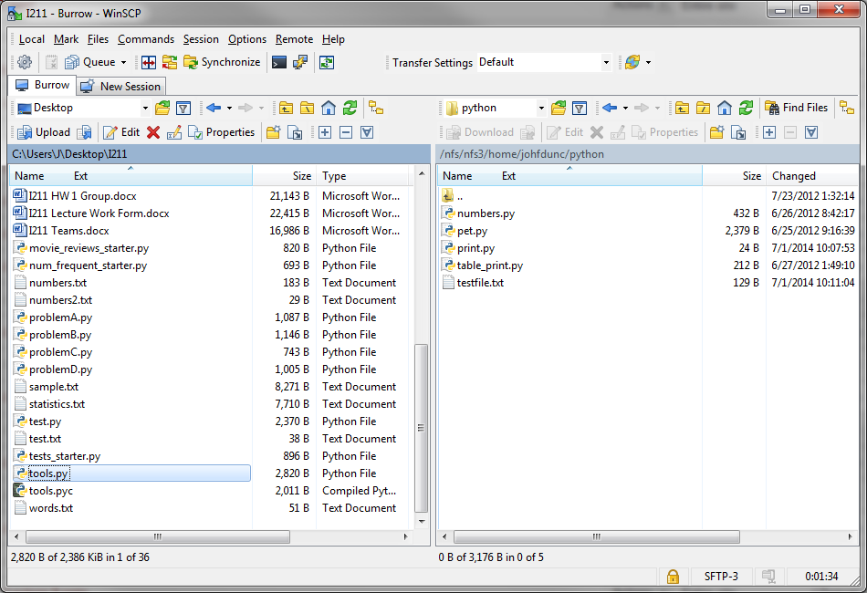
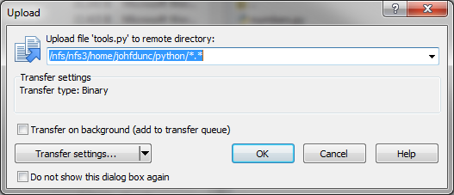
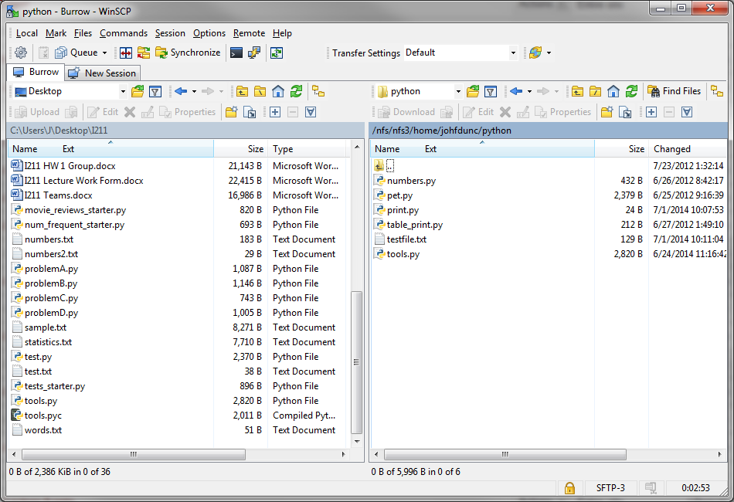
Win SCP
Right click on a file for more options.
In the left window, use UPLOAD.
In the right window, use DOWNLOAD.

Slide 26
Basic UNIX – Running Python
Running python files:
Make sure you’re in the same directory as the python file and type
python <filename.py>
Don’t try to run anything with a GUI!

Slide 27
Basic UNIX – Making an Executable
We can also make a python file executable on the system.
Put this in the first line of the file:
#! /usr/bin/env python
Then, type this in the directory where the file is:
chmod +x <filename.py>
Now you can run it by typing:
./<filename.py>

Slide 28

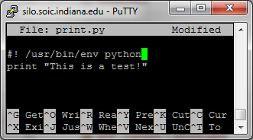
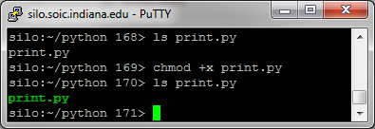
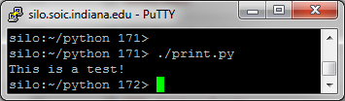
Making an Executable
Making a python file executable:
Executable files show up in green

Slide 29
Server-Side Up (Group Work)
Create a python file called test.py on your local machine. Put a single print statement in it.
Move it over to a Burrow machine using Win SCP, and run it using the python command.
Follow the steps to make it executable, then run it again from the command line.

Slide 30
Questions?

